Slide 1
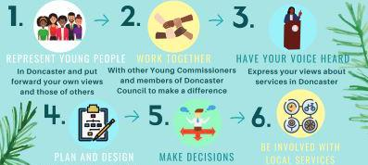
DONCASTER | Child Friendly WHO ARE tell Doncaster
COMMISSIONERS YOUNG
COMMISSIONERS? Daxaster
found
A group of young people who help commission and evaluate provisions and services for children and young people in Doncaster.
Involving young people in decision making is vital we have therefore launched a young Commissioners programme which enables children and young people to be actively involved in all aspects of the commissioning process. following the commissioning cycle.
Our current Young Commissioners were involved with the full commissioning cycle of the Borough's summer Holiday and Food Programme (NAO. Check out their video to find out
more about what they did:
!Mine with out borough-mete aim to 'Make Doncaster the most Child Friendly Borough in the country it is important that the voice of children and yOung people are at the centre of our services and provisions. The Young Commissioners make sure that we are delivering exactly what
children and young people need and want.
SCAN HERE 21
WE ARE LOMOND FOR NEW MEMBERS TO JOIN OUR TEAM WOULD VOU LINE TO...
HAVE YOUR VOICE HEAR
In Doncaster and put With other Young Commissioners Express your views about
forward your own iews and members of Doncaster services in Doncaster
and those of other; Council to make a difference
5. -›6.
4-t-*
err
MAKE DECISIONS
Follow the commissioning cycle with the support of Doncaster Council Officers | Help to shape and improve Make sure they are child community services friendly and young person friendly

